Slide 1
Power line EMI Sensing
Manoj gulati
Date: 25-01-2014

Slide 2
Goal
To study unique and distinct features in conducted EMI generated by multiple electrical appliances.
Specific test cases:
Study impact of voltage fluctuations & building architecture on CE.
Study dissimilar features in CE during w/ and w/o load.
Study effect on CE of a single SMPS(EUT) for different loads.
Study features and unique aspects in CM CE and DM CE for different electrical loads (21-1-2014).

Slide 3
Review: Power line filter design for CE using TDM (Kumar and Agarwal, IITB IEEE Transactions)
Overview: TD technique for design of passive power line CE filters in freq. range 150Khz-30Mhz by CM and DM separation w/o using CM-DM separator and Spectrum analyzer.
Steps:
Signals coming from LISN are fed on 2 channels of DSO.
Both channels are added and subtracted for separating CM-DM noise.
Data is stored in form of text files for computation.
Custom built (filter design software )FDS written running in DSO estimates noise spectrum.
It computes direct FFT, Barlett and Welch periodograms which computes filter component values.
Both techniques were compared on basis of time and computing complexity.

Slide 4
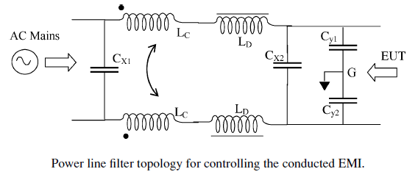
Power line filter topology for CE

Slide 5
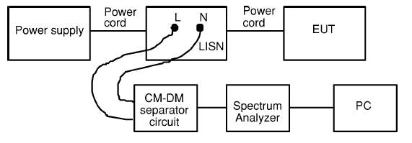
Conventional setup for measurement of CE:

Slide 6
Requirements for conventional CE measurement
LISN
CM-DM separator circuit
Spectrum analyzer
GPIB connection
PC
Setbacks: Complicated setup and difficult to perform quasi peak detection.
TD CE measurement setup is compact and provide promising results using DSOs.

Slide 7
Past works in TD EMI sensing
Prime focus was on radiated EMI.
Few comparisons were there b/w TD and FD.
Similar results in FD as freq. response of micro strip using impulse testing in TD.
Capturing noise in TD then computing FFT and periodograms was considered better due to magnitude and phase information.
TD measurement system can be used to simulate conventional equip. e.g peak, average, RMS and quasi peak detector.

Slide 8
Objective
To reduce accessories required for design of EMI filters like CM-DM noise separator, Signal analyzer, GPIB interface, PC.
Current approach proposes TD method of noise acquisition over FD analysis.
Signals from LISN are fed in to fast sampling DSO having add and subtract function to calculate CM-DM components.
Then using filter design software (running inside DSO) it computes direct FFT and periodograms.
Result from these computations and by analyzing PSD values for different filter components can be calculated.

Slide 9
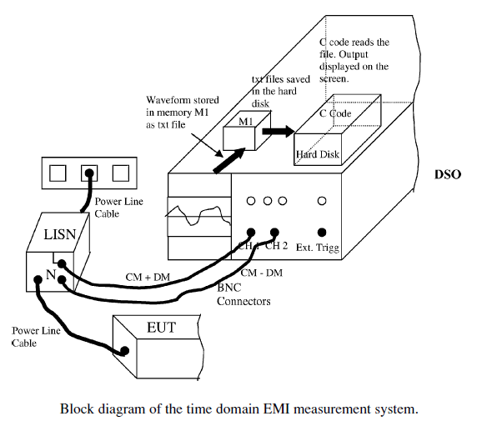
Time Domain measurement system

Slide 10
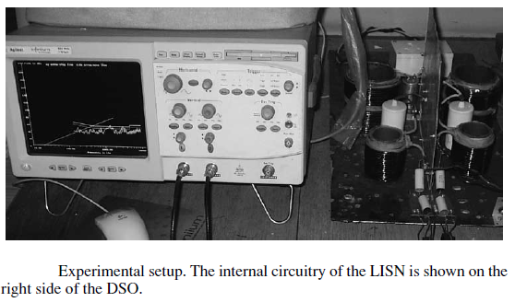
Experimental setup

Slide 11

Time Domain measurements
TD uses LISN to sense line noise.
LISN allows 50/60Hz main suppply in EUT without attenuation.
Noise generated by LISN is filtered and tapped from LISN’s outputs Line and neutral.
EMI on line and neutral follows these relations:
> Vline = VCM + VDM/2 (a)
> Vline = VCM - VDM/2 (b)
The two signals are fed in to two channels of DSO. DSO samples TD signals.
Inbuilt add and subtract features are used to separate CM and DM noise.

Slide 12
Sampled TD data is stored in form of txt files.
# Advantage of this method is that CM and DM noise separation is done in DSO and external separator is not required.

Slide 13
Challenges in CM-DM separator
Both inputs should be identical to each other to avoid errors due to phase shift.
Should be compact and components should be properly mounted to avoid errors due to connections and soldering.
Proper shielding is desired to avoid errors due to radiation interference with the CM-DM separator circuit
Since EMI extends in the MHz frequency range, good quality magnetic cores are required that can operate at high frequency.

Slide 14

Computational Analysis
In this TD approach frequency components are obtained by computing FFT of the sampled data.
In noise signal data where randomness is involved, it is more appropriate to find Power spectral distribution.
Barlett and Welch periodograms are used for this.
Magnitude and power spectrum is computed through DFT applied on time domain signal.
FFT of noth CM and DM components is computed in db (Vmag) and then converted to dbuV (Vmag) as EMC regulations are specified in this.

Slide 15


After this db (Vmag) is converted to dbuV (Vmag) as EMC regulations are specified in this.
Then 6db is added to baseline attenuation so that EMI is below limit line by 6 db.

Slide 16

Spectrum estimation from Barlett and Welch periodograms
Computing freq spectrum of TD signals using Barlett and Welch periodograms.
Periodograms compute average of spectrum obtained from FFT of TD segments of sampled signals.
Spectrum estimation is non parametric as no assumption was made how data was generated.
Barlett approach: N point seq is subdivided in to K non overlapping segments, where each segment has length m.
Periodograms for all k segments are computed and averaged to obtain Barlett power spectrum estimate:

Slide 17

Barlett Periodogram reduces freq. resolution by a factor k .
Advantage is reduction in variance by a factor of k.
Welch periodogram: Data segments are allowed to overlap.
The data segments are windowed prior to computing the periodogram.
The periodograms for all the k segments are computed and averaged to obtain the Welch power spectrum estimate.
Welch periodogram reduces the variance by a factor of 16 k/5 for a 50% overlap.
The advantage of the Welch power spectrum estimate is that the variance is smaller than that obtained with the Bartlett power spectrum estimate.
Barlett Periodogram is preferred over Welch as it requires less memory storage.

Slide 18
References
Power Line Filter Design for Conducted Electromagnetic Interference Using Time-Domain Measurements.

